Slide 1
Teaching for Mastery 2019 -2020
Launch Meeting

Slide 2
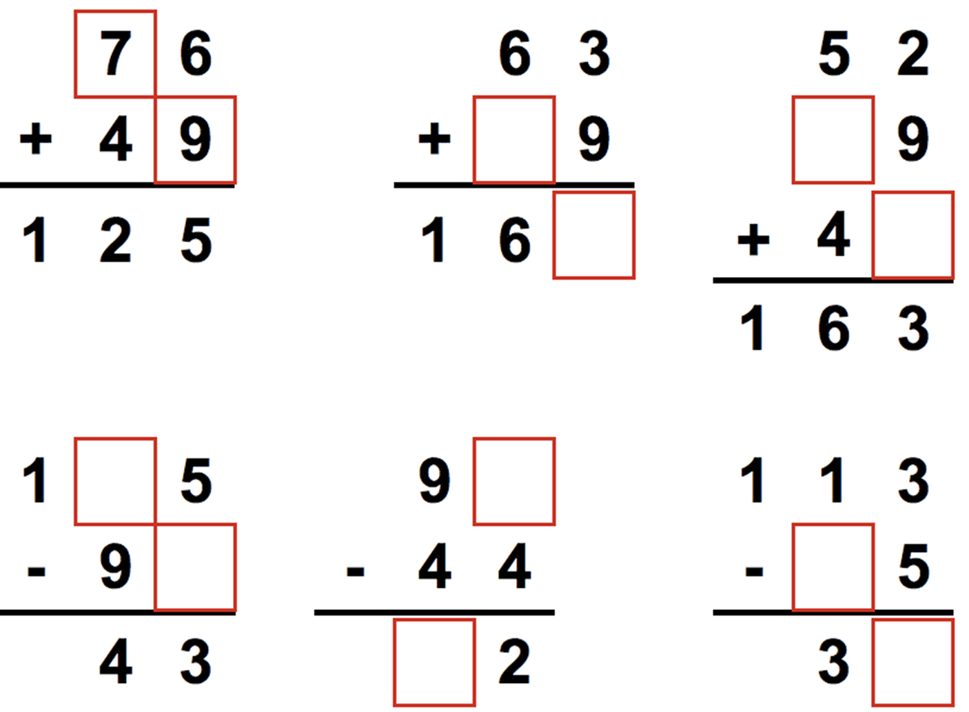
Just some maths to start with..
9
6
2
2
5
6
2
7
5
8
Notes:
Jot down the skills you needed to be able to complete these calculations. Looking at the bottom set of calculations – is there anything you would do differently and why?
To be able to complete these calculations you needed to have mastered the commutative relationship between addition and subtraction. Number bonds to 20. The concept of sum and difference and the formality of column addition and subtraction.

Slide 3
The aims of this morning
To outline the role of Maths Hubs
To clarify what you can expect from the Teaching for Mastery Programme
To detail what is expected of you as a participating school.

Slide 4
What Are Maths Hubs?
There are 37 Maths Hubs that together serve all the regions of England. Each Maths Hub is open to working with any schools and colleges, from early years providers to post-16 institutions, in the broad geographical area that it covers. The benefits for schools and colleges engaging with their local Maths Hubs include:
Access to free or subsidised professional development programmes
Up-to-date information about all local maths education activities
Participation in a network of local leaders of maths educations (LLMEs).
http://www.mathshubs.org.uk/about-maths-hubs/

Slide 5
Maths Hubs
Each Maths Hub is a partnership, led locally by an outstanding school or college. The lead school identifies strategic partners, who help plan and evaluate the hub’s work, and operational partners, who help carry out the hub’s work. So, the hub is not just the lead school or college – instead it is more like a maths leadership network involving schools, colleges and other organisations with maths education expertise from across the hub’s area

Slide 6
The principle financial sponsor of Maths Hubs is the DfE.
The Maths Hubs network benefits from the support of a number of Strategic Advisers. These include Ofsted, the Teaching School Council, the Joint Mathematical Council (JMC), and the Advisory Committee on Mathematics Education (ACME).

Slide 7
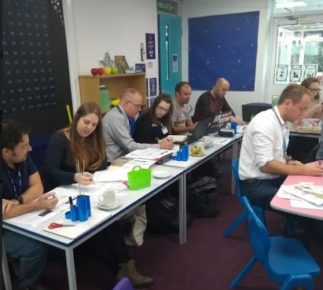
Teaching for Mastery Programme
This is the third year of the programme in Cornwall in which schools develop the teaching of mathematics in their school, working alongside a mastery specialist. To date 119 primary schools have engaged in the Teaching for Mastery programme and again we have had more applications than places. This year 50 schools are involved.

Slide 8
Notes:
The objectives of teaching of mastery are…

Slide 9
Mastery is characterised by the belief that, by working hard, all children are capable of succeeding at mathematics.
Whole class teaching
Carefully structured, small step lessons
Deeper understanding which leads to generalisation
The application of skills across different contexts
10-15 min same day intervention for those who need additional support.

Slide 10
Mastery Readiness
The Teaching for Mastery Programme
Sustaining and Embedding Mastery

Slide 11
Teaching for Mastery Programme
Assigned a Teaching for Mastery Specialist
Receive a school visit each term
Receive a total of £1000 to support the release of the designated teachers
Receive match funding towards authorised textbooks
A programme of teacher subject training to develop a secure understanding of the 5 Big Ideas.
Notes:
What can you expect?

Slide 12
Colin Bacon
Chris Gould
David Hick
Catlin Horsley
Josh Lury
Jo Makin-Isherwood
Primary Teaching for Mastery Lead
Kim Rogers
Sharon Neale
Anne Fishwick
Nicola Price
Steve Proctor
Jenna Stobbs
Sarah Smith
Shelley Beckerleg
Ross Barnes

Slide 13
Mastery Specialist School Visits
Staff Meeting
Learning Walk
Book Looks
School Action Planning Support
Lesson Observation

Slide 14
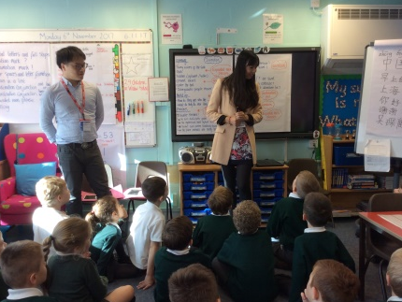
SLA Agreement

Slide 15
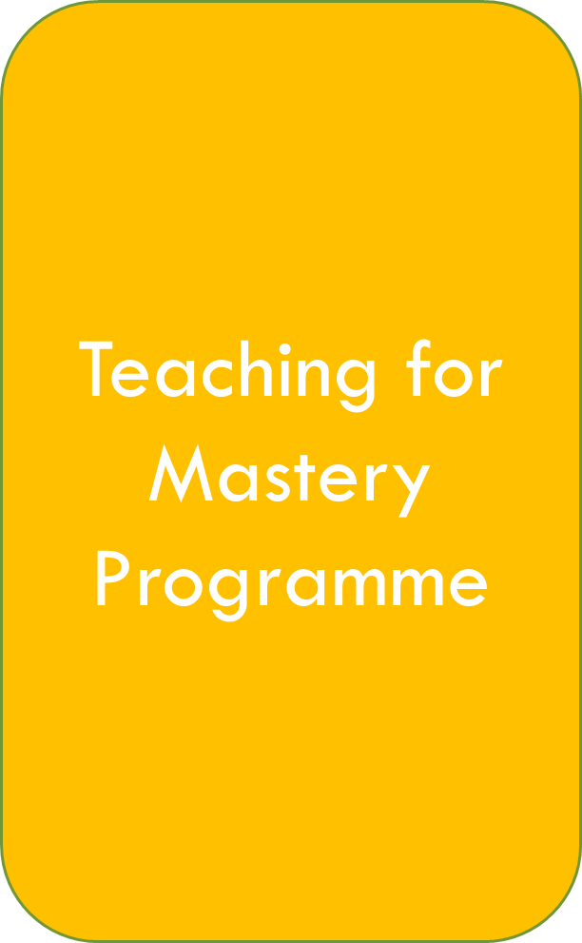
Select two teachers to take part in the programme and help develop maths in your school (participants)
The teachers are to attend all face to face training sessions.
Teachers will work collaboratively with other schools which includes peer to peer observations.
Teachers will keep a reflective log
Head teacher will meet with the Mastery Specialist during school visits
At the end of the year each school will submit online evaluation.

Slide 16
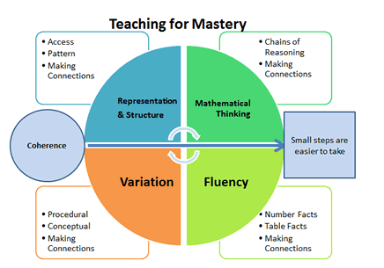
The Programme
Fluency
Reasoning
Problem Solving

Slide 17
Fluency
Reasoning
Problem
Solving

Slide 18
What have People Said?
Many thanks for your report - some great ideas to move us forward in maths. Looking forward to the next visit.
Our participating teacher has developed fantastically through the engagement and this has already impacted across the school. I could not recommend the programme highly enough.
Katy and Jo are being amazing and throwing themselves into this new approach with gusto! We are already seeing an impact on our learners!
. The maths lead has relayed that the work done has revolutionised the way she thinks about teaching maths.

Slide 19
What now?
You will have been contacted by your Mastery Specialist who has invited you to your first face to face session. This is a lesson demonstration and a workshop. ( Half Day)
Please bring your diary to confirm all of the dates for face to face sessions. You will need a lap top to download the reflection log and also to log onto the NCETM
Expect to receive your SLA via email. Return this as soon as possible.
Please ensure you have registered with your email address and NCETM username.

